Slide 1
CST-111 Introduction to Computer Science and Information Technology Topic 5
Notes:
Find four textbook examples to use as student activities, set aside time for students to do assignment; consider check sheet to reduce grading.

Slide 2
Restart Recording
Start the VM. We will be using it shortly.

Slide 3
Lord,
I know that worrying gets me nowhere, yet I still sometimes allow it to consume me.
In times such as these, Lord, I ask you to grant me a great amount of strength, faith and courage to fight off the doubt and fear within my mind.
Faith casts out fear while fear casts out faith. Help me to choose faith.
Amen
https://www.pinterest.com/pin/501307002277165351 (modified)

Slide 4
Technology Announcements
March 3rd, 2021

Slide 5


Slide 6


Slide 7


Slide 8


Slide 9


Slide 10


Slide 11
Scholarship Opportunity
The application deadline is Friday, March 19, 2021
Eligibility Requirements
Be entering junior year or higher in fall 2021; fifth year, masters and PhD candidates as well as community college transfers are encouraged to apply
GPA minimum of 3.0 (or equivalent)
Be interested in pursuing a career in Internal Audit

Slide 12


Slide 13
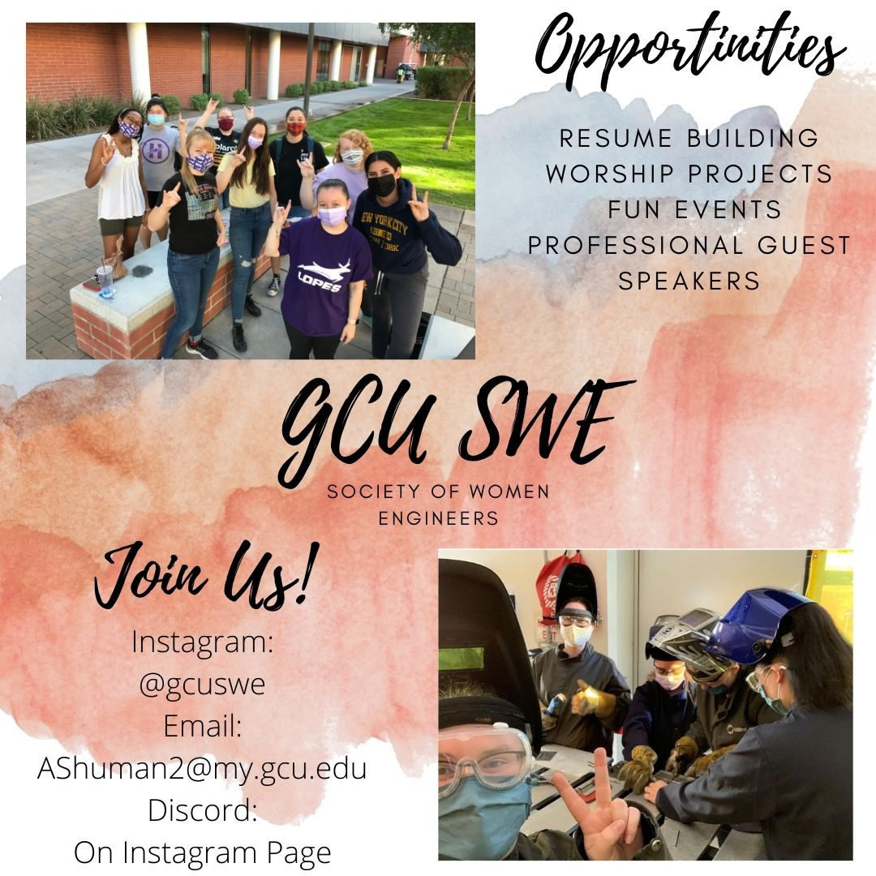

Slide 14
This Week--Homecoming
(All events online and available anytime during week except where noted)
A message from President Mueller: President Brian Mueller shares a special message for students, alumni and their families with updates on the current state of the University and future projects
Virtual campus tours: Showcases GCU landmarks as well as new additions to campus that alumni might not have seen
Cooking with the Herd: Cook breakfast of blueberry pancakes or ham and cheese omelet alongside Canyon 49 Grill chef Mike Willison
Alumni Hall of Fame: Office of Alumni Relations celebrates this year’s inductees – Dan Snyder, Rachel Winkler, Garth Bailey and Scott Van Newkirk
GCU Flashback Archives: Explore GCU’s history through a collection of photos and yearbooks
TikTok competition: Create TikTok videos for a chance to win cash prizes at the Lope Shop. Hashtag #HCFW21.
Live student performances: noon Tuesday through Friday, streamed live from Student Union Promenade on GCU’s YouTube Page. Fans of game show "Family Feud" are in for a treat.
Lope Nation Watch Party: Watch GCU men's basketball team play, 6:30 p.m. Friday-Saturday

Slide 15
This Week--General
Conference: Honors College Next Generation Leadership Conference, in person Friday, Canyon 49 Grill; in person and online Saturday, Colangelo College of Business Building

Slide 16
This week--Athletics
Beach volleyball: vs. Park, 1 p.m. Friday, GCU Beach Volleyball Stadium
Beach volleyball: vs. Texas A&M-Corpus Christi, 3 p.m. Friday, GCU Beach Volleyball Stadium
Men's basketball: vs. Utah Valley, 7 p.m. Friday, GCU Arena. TV: Fox 10 Xtra (Ch. 45, cable 9). Radio: 1580 AM, 99.3 FM, 25.9 FM. GCUTV
Softball: vs. Northern Illinois, 1 p.m. Saturday, GCU Softball Stadium GCUTV
Women's soccer: vs. New Mexico State, 2 p.m. Saturday, GCU Stadium GCUTV
Softball: vs. Northern Illinois, 3:30 p.m. Saturday, GCU Softball Stadium GCUTV
Men's basketball: vs. Utah Valley, 7 p.m. Saturday, GCU Arena. TV: Fox 10 Xtra (Ch. 45, cable 9). Radio: 1580 AM, 99.3 FM, 25.9 FM. GCUTV
Men's soccer: vs. Air Force, 7 p.m. Saturday, GCU Stadium GCUTV

Slide 17
Topic 5: Advanced Functions, OOP, and Multi-Function Programming
Objectives:
Design a schema that corresponds to a problem statement.
Implement the schema in a database by creating a set of interrelated tables.
Populate the tables with data.

Slide 18
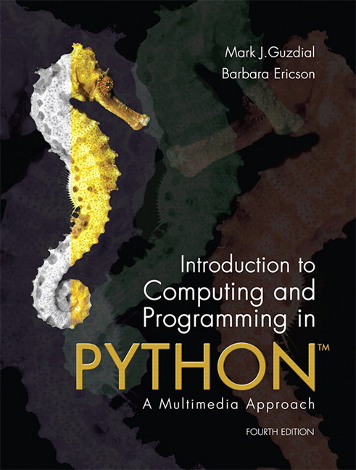
Introduction to Computing and Programming in Python: A Multimedia Approach 4ed
Chapter 8:
Modifying Samples in a Range

Slide 19
Knowing where we are in the sound
More complex operations require us to know where we are in the sound, which sample
Not just process all the samples exactly the same
Examples:
Reversing a sound
It's just copying, like we did with pixels
Changing the frequency of a sound
Using sampling, like we did with pixels
Splicing sounds

Slide 20
Using for to count with range
>>> print range(1,3)
[1, 2]
>>> print range(3,1)
[]
>>> print range(-1,5)
[-1, 0, 1, 2, 3, 4]
>>> print range(1,100)
[1, 2, 3, 4, 5, 6, 7, 8, 9, 10, 11, … 99]

Slide 21
Increasing volume by sample index
def increaseVolumeByRange(sound):
for sampleNumber in range(0, getLength(sound)):
value = getSampleValueAt(sound, sampleNumber)
setSampleValueAt(sound, sampleNumber, value * 2)
This really is the same as:
def increaseVolume(sound):
for sample in getSamples(sound):
value = getSample(sample)
setSample(sample,value * 2)

Slide 22
Modify different sound sections
The index lets us modify parts of the sound now - e.g. here we increase the volume in the first half, and then decrease it in the second half.
def increaseAndDecrease(sound):
length = getLength(sound)
for index in range(0, length/2):
value = getSampleValueAt(sound, index)
setSampleValueAt(sound, index, value*2)
for sampleIndex in range(length/2, length):
value = getSampleValueAt(sound, index)
setSampleValueAt(sound, index, value*0.2)

Slide 23
Array References
Square brackets ([ ]) are standard notation for arrays (or lists). To access a single array element at position index, we use array[index]
>>> myArray = range(0, 100)
>>> print myArray[0]
0
>>> print myArray[1]
1
>>> print myArray[99]
99

Slide 24
Splicing Sounds
Splicing gets its name from literally cutting and pasting pieces of magnetic tape together
Doing it digitally is easy (in principle), but painstaking
The easiest kind of splicing is when the component sounds are in separate files.
All we need to do is copy each sound, in order, into a target sound.
Here's a recipe that creates the start of a sentence, “Guzdial is …” (You may complete the sentence.)

Slide 25
Splicing whole sound files
def merge():
guzdial = makeSound(getMediaPath("guzdial.wav"))
isSound = makeSound(getMediaPath("is.wav"))
target = makeSound(getMediaPath("sec3silence.wav"))
index = 0
for source in range(0, getLength(guzdial)):
value = getSampleValueAt(guzdial, source)
setSampleValueAt(target, index, value)
index = index + 1
for source in range(0, int(0.1*getSamplingRate(target))):
setSampleValueAt(target, index, 0)
index = index + 1
for source in range(0, getLength(isSound)):
value = getSampleValueAt(isSound, source)
setSampleValueAt(target, index, value)
index = index + 1
normalize(target)
play(target)
return target

Slide 26
How it works
Creates sound objects for the words “Guzdial”, “is” and the target silence
Set target's index to 0, then let each loop increment index and end the loop by leaving index at the next empty sample ready for the next loop
The 1st loop copies “Guzdial” into the target
The 2nd loop creates 0.1 seconds of silence
The 3rd loop copies “is” into the target
Then we normalize the sound to make it louder

Slide 27
Splicing words into a speech
Say we want to splice pieces of speech together:
We find where the end points of words are
We copy the samples into the right places to make the words come out as we want them
(We can also change the volume of the words as we move them, to increase or decrease emphasis and make it sound more natural.)

Slide 28
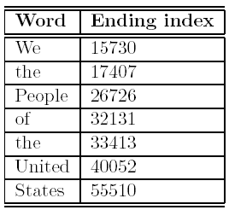
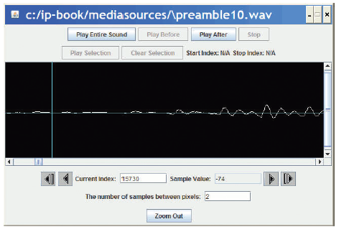
Finding the word end-points
Using MediaTools and play before/after cursor, we can figure out the index numbers where each word ends
We want to splice a copy of the word “United” after “We the” so that it says, “We the United People of the United States”.

Slide 29
Now, it's all about copying
We have to keep track of the source and target indices, srcSample and destSample
destSample = Where-the-incoming-sound-should-start
for srcSample in range(startingPoint, endingPoint):
sampleValue = getSampleValueAt(source, srcSample)
setSampleValueAt(dest, destSample, sampleValue)
destSample = destSample + 1

Slide 30
The Whole Splice
def splicePreamble():
file = getMediaPath(“preamble10.wav”)
source = makeSound(file)
target = makeSound(file) # This will be the newly spliced sound
targetIndex =17408 # targetIndex starts at just after "We the" in the new sound
for sourceIndex in range( 33414, 40052): # Where the word "United" is in the sound
setSampleValueAt(target, targetIndex, getSampleValueAt(source, sourceIndex))
targetIndex = targetIndex + 1
for sourceIndex in range(17408, 26726): # Where the word "People" is in the sound
setSampleValueAt(target , targetIndex, getSampleValueAt(source, sourceIndex))
targetIndex = targetIndex + 1
for index in range(0, 1000): #Stick some quiet space after that
setSampleValueAt(target, targetIndex, 0)
targetIndex = targetIndex + 1
play(target) #Let's hear and return the result
return target

Slide 31

What's going on here?
First, set up a source and target.
Next, we copy “United” (samples 33414 to 40052) after “We the” (sample 17408)
That means that we end up at 17408+(40052-33414) = 17408+6638=24046
Where does “People” start?
Next, we copy “People” (17408 to 26726) immediately afterward.
Do we have to copy “of” to?
Or is there a pause in there that we can make use of?
Finally, we insert a little (1/1441th of a second) of space – 0's

Slide 32
What if we didn't do that second copy? Or the pause?
def spliceSimpler():
file = getMediaPath(“preamble10.wav”)
source = makeSound(file)
target = makeSound(file) # This will be the newly spliced sound
targetIndex =17408 # targetIndex starts at just after "We the" in the new sound
for sourceIndex in range( 33414, 40052): # Where the word "United" is in the sound
setSampleValueAt(target, targetIndex, getSampleValueAt(source, sourceIndex))
targetIndex = targetIndex + 1
# Let's hear and return the result
play(target)
return target

Slide 33
General clip function
We can simplify those splicing functions if we had a general clip method that took a start and end index and returned a new sound clip with just that part of the original sound in it.
def clip(source, start, end):
target = makeEmptySound(end - start)
tIndex = 0
for sIndex in range(start, end):
value = getSampleValueAt(source, sIndex)
setSampleValueAt(target, tIndex, value)
tIndex = tIndex + 1
return target

Slide 34
General copy function
We can also simplify splicing if we had a general copy method that took a source and target sounds and copied the source into the target starting at a specified target location.
def copy(source, target, start):
tIndex = start
for sIndex in range(0, getLength(source)):
value = getSampleValueAt(source, sIndex)
setSampleValueAt(target, tIndex, value)
tIndex = tIndex + 1

Slide 35
Simplified preamble splice
Now we can use these functions to insert “United” into the preamble in a much simpler way.
def createNewPreamble():
file = getMediaPath("preamble10.wav")
preamble = makeSound(file) # old preamble
united = clip(preamble, 33414, 40052) # "United"
start = clip(preamble, 0, 17407) # "We the"
end = clip(preamble, 17408, 55510) # the rest
len = getLength(start) + getLength(united)
len = len + getLength(end) # length of everything
newPre = makeEmptySound(len) # new preamble
copy(start, newPre, 0)
copy(united, newPre, getLength(start))
copy(end, newPre, getLength(start)+getLength(united))
return newPre

Slide 36
Changing the splice
What if we wanted to increase or decrease the volume of an inserted word?
Simple! Multiply each sample by something as it's pulled from the source.
Could we do something like slowly increase volume (emphasis) or normalize the sound?
Sure! Just like we've done in past programs, but instead of working across all samples, we work across only the samples in that sound!

Slide 37
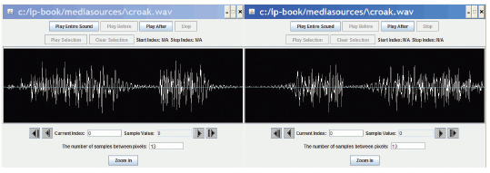
Reversing Sounds
We can also modify sounds by reversing them
def reverse(source):
target = makeEmptySound(getLength(source))
sourceIndex = getLength(source) - 1 # start at end
for targetIndex in range(0, getLength(target)):
value = getSampleValueAt(source, sourceIndex)
setSampleValueAt(target, targetIndex, value)
sourceIndex = sourceIndex - 1 # move backwards
return target

Slide 38
Clicker: What does makeEmptySong take as input?
Based on that last program, what do you think makeEmptySong takes as input?
Number of samples needed in the new song.
Number of bytes needed in the new sound.
Number of seconds needed in the new song.
A song to copy.

Slide 39
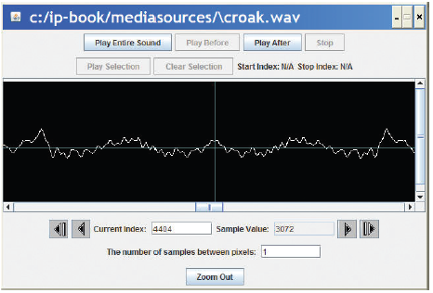
Mirroring
We can mirror sounds in exactly the same way we mirrored pictures
def mirrorSound(sound):
len = getLength(sound)
mirrorpoint = len/2
for index in range(0, mirrorpoint):
left = getSampleObjectAt(sound, index)
right = getSampleObjectAt(sound, len-index-1)
value = getSampleValue(left)
setSampleValue(right, value)

Slide 40
Functions and Scope
Defined:
Let's call the variable that represents the input a “parameter variable”
Key idea:
The parameter variable in a function has NOTHING to do with any variable (even with the same name) in the Command Area – or anywhere else.
Parameter variables are LOCAL to the function.
We say that it's in the function's SCOPE.

Slide 41
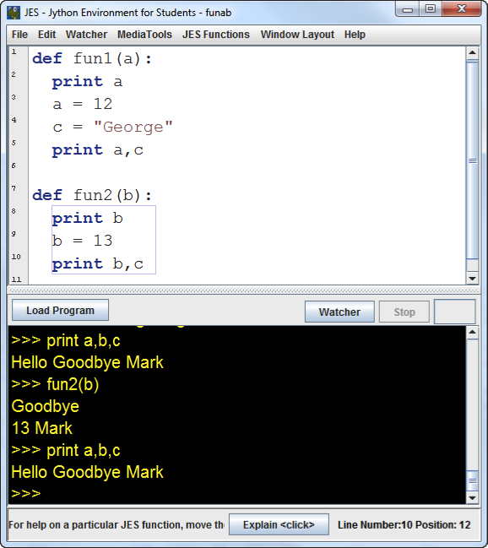
Think this through:

Slide 42
Values are copied into parameters
When a function is called, the input values are copied into the parameter variables.
Changing the parameter variables can't change the input variables.
All variables that are local disappear at the end of the function.
We can reference variables external to the function, if we don't have a local variable with the same name.

Slide 43
Parameters as Objects
Note: Slightly different when you pass an object, like a Sound or a Picture.
You still can't change the original variable, but you've passed in the object. You can change the object.
>>> p = makePicture(pickAFile())
>>> increaseRed(p)
increaseRed() can't change the variable p, but it can apply functions and methods to change the picture that p references.
That picture, the object, is the value that we passed in to the function.

Slide 44
Tasks--Python: Sound Splicing
Description:
The purpose of this assignment is to use Python to manipulate and modify audio WAV files into loops.
Use the Web to search and download sounds for an antelope and a rabbit. WAV file formats are required.
Use Python to splice the two sounds together.
Submit the following in compressed, zip file format:
Your Python program. Naming convention is: firstInitial+lastName+Splicey.py. Example: gdiltsSplicey.py
Include all the media files used by or created by the program
At least one screen capture demonstrating that your program was functional.
ZIP file naming convention is: FirstInitial+LastName+soundSplicing.zip
GCU style is not required, but solid academic writing is expected.
You are not required to submit this assignment to LopesWrite.

Slide 45
Questions? Comments?
What did we do today?
What was valuable to you?
What should be expanded?
What should I leave out next time?
What should receive less emphasis?
What do you need me to review next time?

